Slide 1
Receipt & Invoice Digitizer
Team A

Slide 2
Team Member Introduction & Contribution
Ankit Sharma
Frontend development using React
Dashboard UI design
Receipt download feature implementation
Hemanjali Kodali
Backend development using FastAPI
API creation and routing
Rethika
OCR integration using Tesseract
Image text extraction
Sandana Aini
AI model integration for receipt data extraction
Structuring invoice information
Nirupam pardhu Nakketla
Analytics dashboard implementation
Chart visualization and chatbot integration

Slide 3
Problem Statement
Managing receipts manually is difficult because:
Receipts can be easily lost
Manual data entry is time consuming
Difficult to track expenses
No spending insights available
Objective
The objective of this project is to build a system that:
Automatically extracts data from receipts
Stores receipt information digitally
Provides spending analytics
Assists users through a chatbot interface

Slide 4
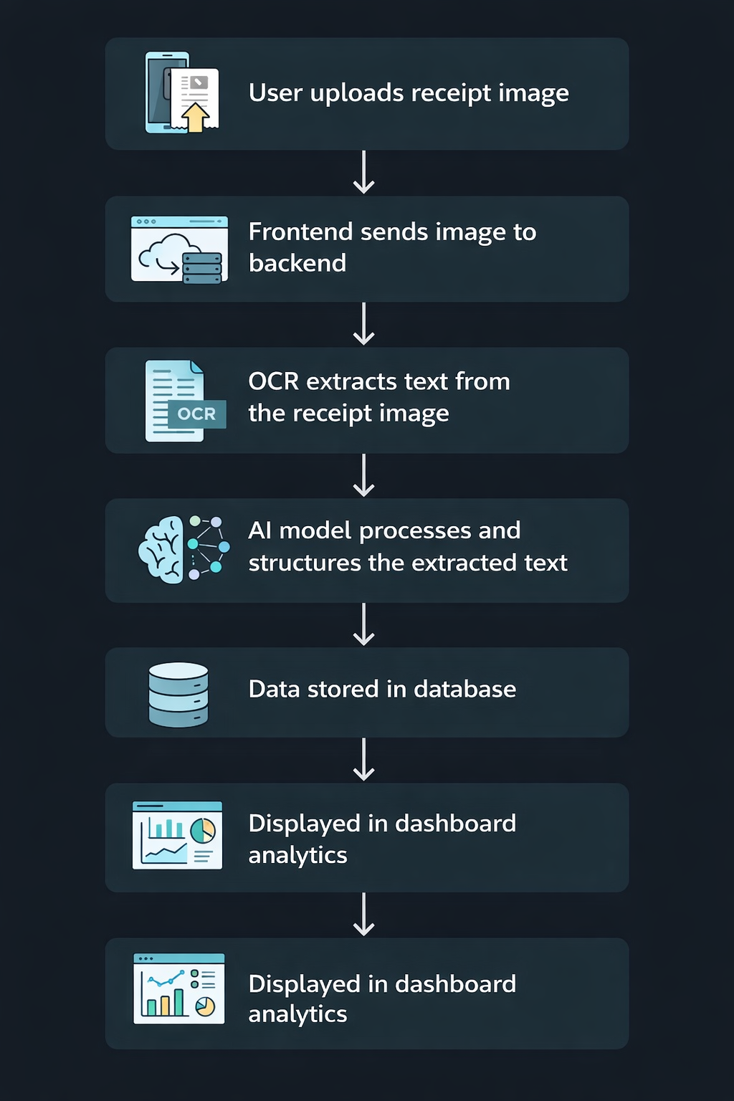
Architecture & Workflow

Slide 5
Technology Stack
Frontend
React
Tailwind CSS
Recharts (for analytics charts)
Backend
FastAPI (Python)
AI & OCR
Tesseract OCR
Gemini AI for structured data extraction
Database
SQL database for storing receipts
Tools
GitHub for version control
VS Code for development

Slide 6
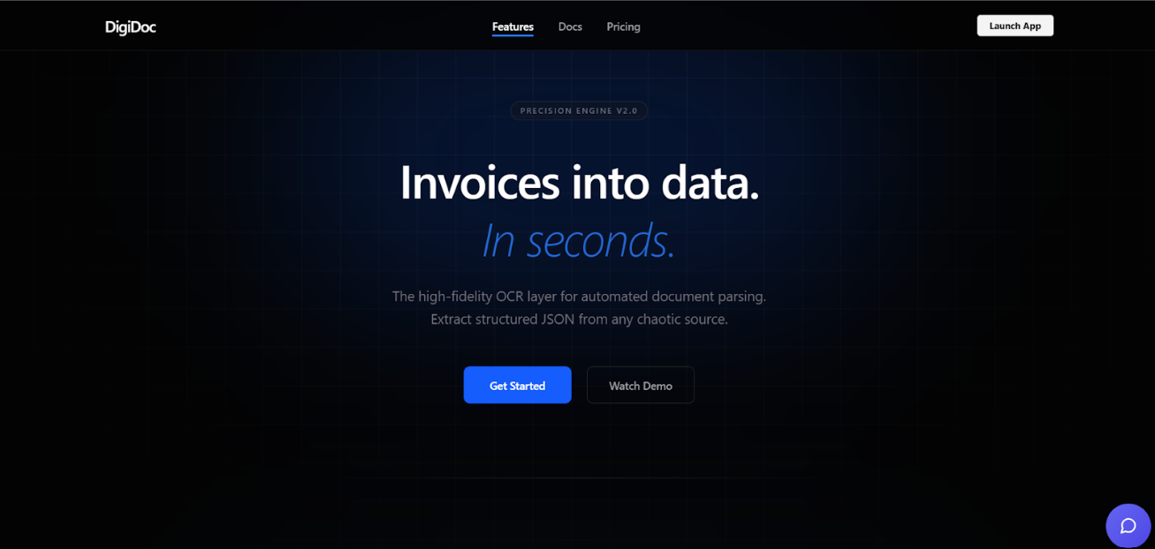
Screenshots
Landing Page
Introduces the Receipt and Invoice Digitizer platform
Converts invoices and receipts into structured data using OCR technology
Navigation bar includes Features, Docs, Pricing, and Launch App
"Get Started" and "Watch Demo" buttons allow users to quickly access the system
Clean and modern design that clearly explains the platform’s purpose

Slide 7
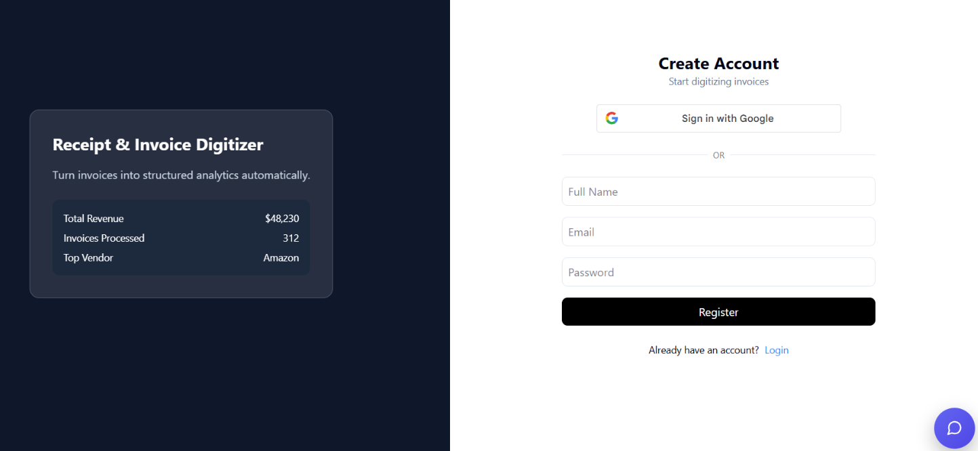
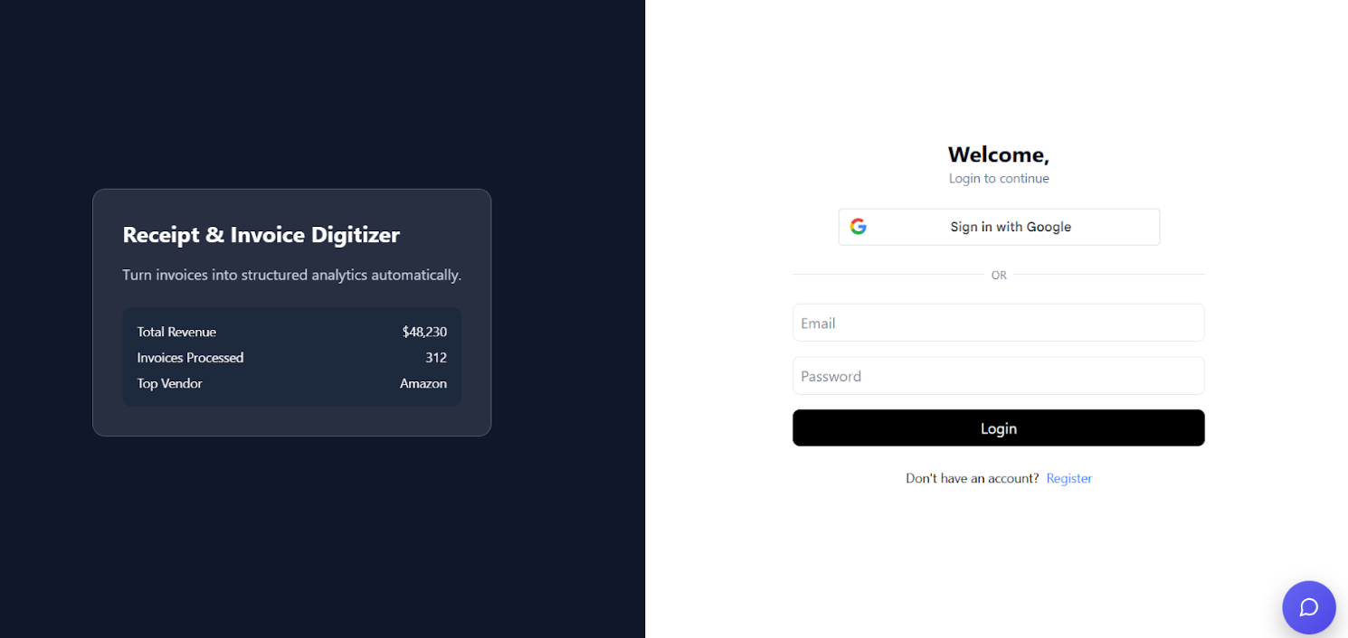
Registration Page
Allows new users to create an account to access the system
Users can sign up using Google or register with name, email, and password
Simple and clean form for quick registration
Secure account creation to start digitizing receipts and invoices
Login Page
Allows existing users to log in to their account
Users can sign in using Google or email and password
Provides quick access to the platform dashboard
Includes a Register option for new users who do not have an account

Slide 8
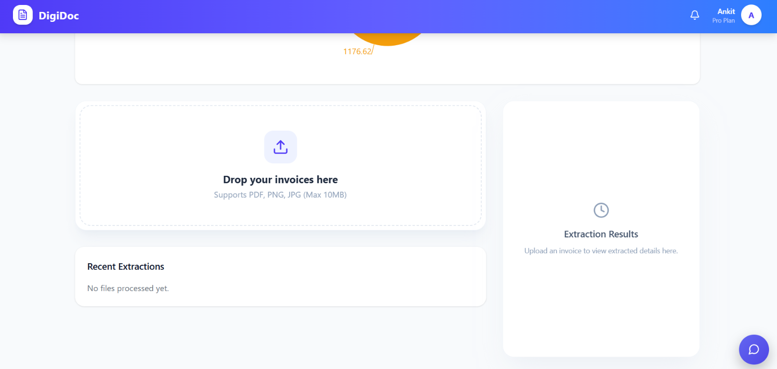
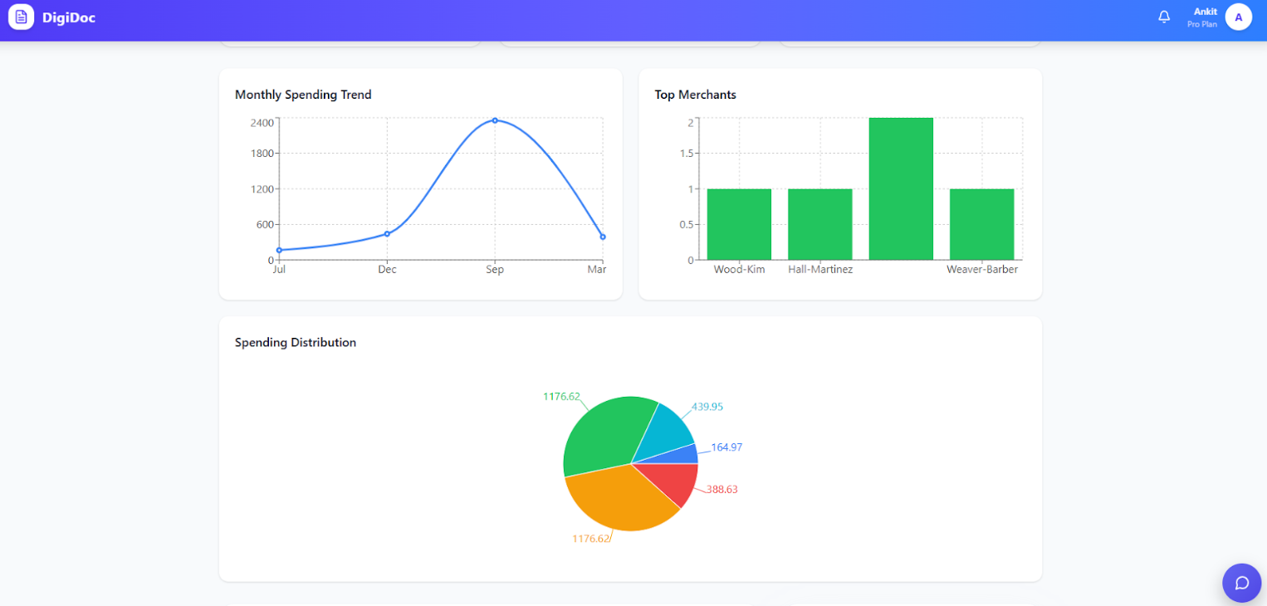
Dashboard
Central page where users manage invoices and receipts
Users can upload invoices (PDF, PNG, JPG) for processing
Shows recent extractions of uploaded invoices
Displays extraction results after OCR processing
Simple interface for quick document upload and tracking
Analytics
Shows visual insights from processed invoices
Monthly spending trend graph to track expenses over time
Top merchants chart showing most frequent vendors
Spending distribution pie chart for category-wise analysis
Helps users understand spending patterns and financial insights

Slide 9
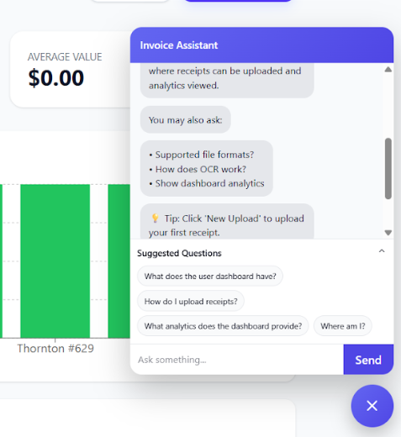
Chatbot / Invoice Assistant
Provides interactive assistance to users within the dashboard
Answers common questions about uploading receipts, OCR process, and analytics
Displays suggested questions for quick help
Guides users on how to upload invoices and use system features
Improves user experience by providing instant support without manual help

Slide 10
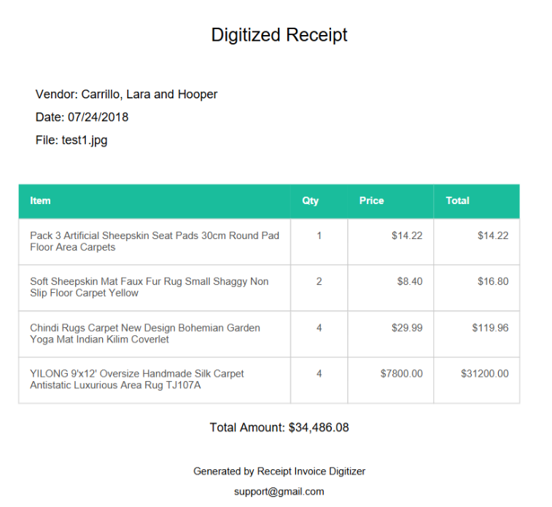
Digitized Receipt
Displays the structured receipt information extracted using OCR
Shows important details like vendor name, date, and file name
Lists all purchased items with quantity, price, and total amount
Automatically calculates the overall total of the receipt
Converts unstructured receipt images into organized digital data for easy analysis

Slide 11
Feature Enhancement
Additional features implemented in the system:
Analytics Dashboard with charts
Receipt download as digitized document
Chatbot for assisting users
Dark mode UI
Automatic extraction of purchased items
Future enhancements can include:
Mobile application
Budget tracking
Advanced AI insights

Slide 12
Conclusion
The Receipt & Invoice Digitizer system successfully:
Automates receipt digitization
Extracts key information using OCR and AI
Stores receipts digitally
Provides analytics insights
Improves expense tracking efficiency
This project demonstrates how AI and automation can simplify financial record management.

